Slide 1
Chapter - 9
Working capital management( N - 5 to 12Marks)

Slide 2
Concept of working capital
Working capital means capital required for day to day operation of an organization. It is concerned with current assets and current liabilities.
Working capital is a lifeblood of organization without working capital organization can’t operate regularly
Working capital management ensures the best utilization of a business's current assets and liabilities for the company's effective operation. The main aim of managing working capital is to monitor a company's assets and liabilities to maintain adequate cash flow and meet short-term business goals.
There are mainly two concept of working capital
i. Gross concept
Working capital = Total current assets
Ii. Net concept
Net working capital = Current Assets - Current liabilities

Slide 3
Concept of Working Capital Management
Working capital management covers all decision of an organization involving cash flows in the short run with emphasis on the management of investment in current assets and current liabilities.
It is concerned with the problems that arise in attempting to manage the current assets, the current liabilities and the inter-relationship that exists between them.
The level of working capital must be just optimal,neither more nor less.
The basic purpose of short term financial management is to enable a firm to maintain the investment in current assets at optimum level that maintains a proper trade off between profitability and risk
The requirement of working capital may vary from firm to firm due to the unpredictable nature of cash inflow from current assets and almost certain cash outflow associated with current liabilities.

Slide 4
Concept of operating cycle and the cash cycle
The time duration required to convert raw material into finished goods and then realize cash by selling them is called operating cycle or working capital cycle.
The time intervals between outflow of cash and inflow through sales and collection from customers is called cash cycle or cash conversion cycle.
The difference between operating cycle and payable deferral period is known as cash conversion cycle.
CCC is the average length of time period required for conversion of cash outflows and inflows
Inventory conversion Period (ICP):- ICP is the length of time required for conversion of raw material into finished goods and then into sales
Receivables conversion period(RCP):- RCP is the average length of time required for collection of account receivable from credit customers after products have been sold off.
Payable deferral period (PDP):- The average length of time required for payment of credit purchase and accruals is known as PDP.

Slide 5
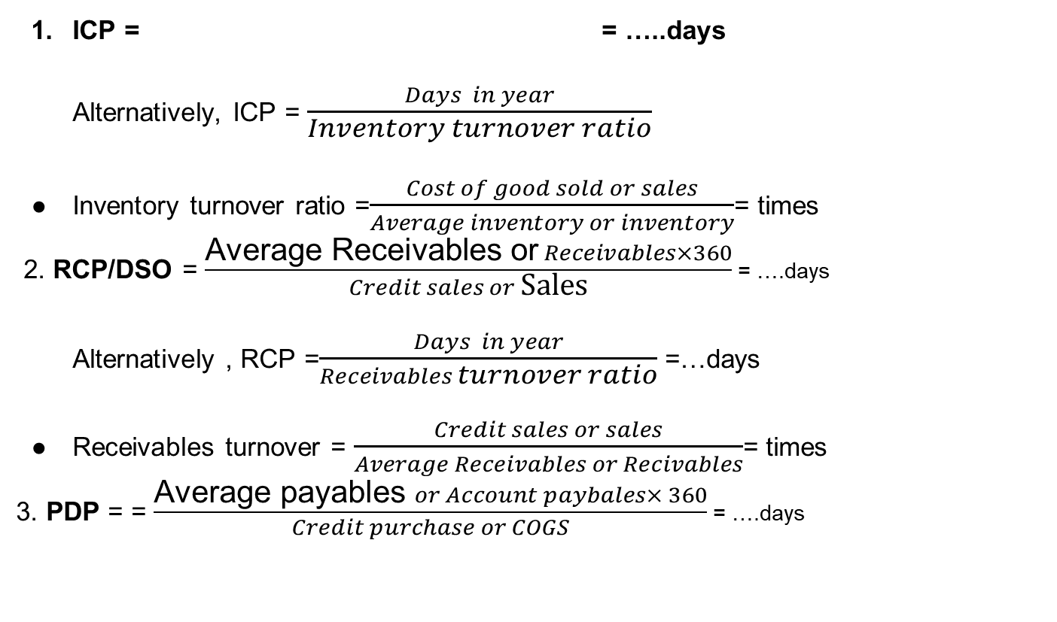

ICP = = …..days
Alternatively, ICP = $\frac{Days in year}{Inventory turnover ratio}$
Inventory turnover ratio =$\frac{Cost of good sold or sales}{Average inventory or inventory}$= times
2. RCP/DSO = $\frac{\text{Average} \text{Receivables} \text{or} Receivables×360}{Credit sales or \text{Sales}}$ = ….days
Alternatively , RCP =$\frac{Days in year}{Receivables turnover ratio}$ =…days
Receivables turnover = $\frac{Credit sales or sales}{Average Receivables or Recivables}$= times
3. PDP = = $\frac{\text{Average} \text{payables} or Account paybales× 360}{Credit purchase or COGS}$ = ….days
$$\frac{\text{Average} \text{Inventory} \text{or} \text{inventory}×360}{\text{C}\text{ost} \text{of} \text{good} \text{sold} \text{or} \text{sales}}$$

Slide 6
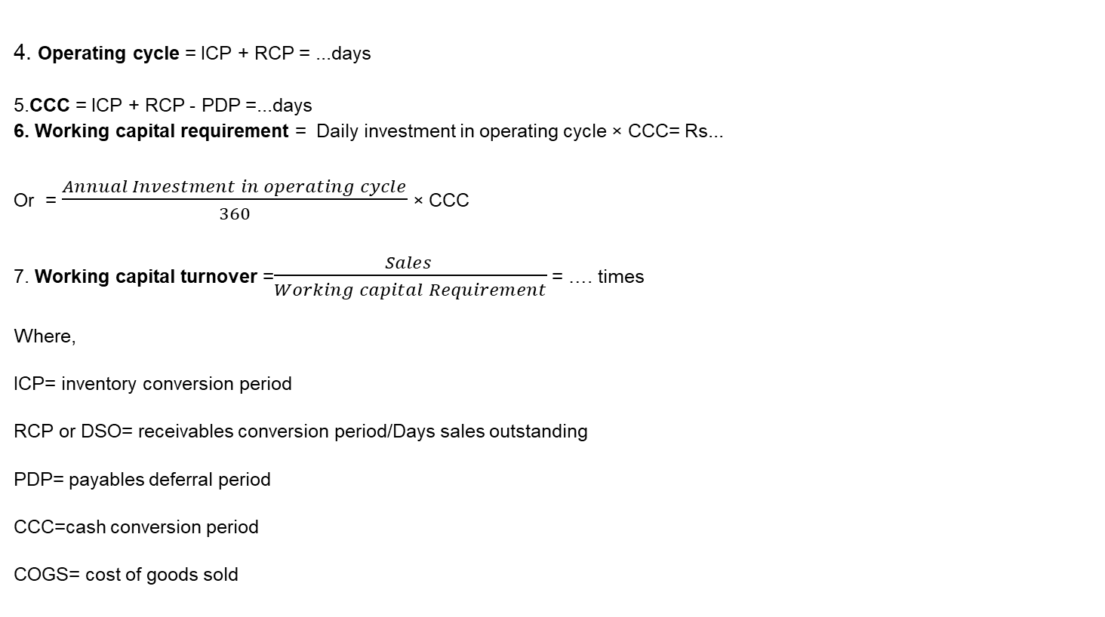
4. Operating cycle = ICP + RCP = ...days
5.CCC = ICP + RCP - PDP =...days
6. Working capital requirement = Daily investment in operating cycle × CCC= Rs...
Or = $\frac{Annual Investment in operating cycle}{360}$ × CCC
7. Working capital turnover =$\frac{Sales }{Working capital Requirement}$ = …. times
Where,
ICP= inventory conversion period
RCP or DSO= receivables conversion period/Days sales outstanding
PDP= payables deferral period
CCC=cash conversion period
COGS= cost of goods sold

Slide 7
Working capital policies
Working capital policies includes working capital investment and financing policy
Conservative/relaxed policy:-
Under this policy the firm carries significantly larger amount of current assets in the form of cash marketable securities,receivables and inventory than under other policies.
Under this policy finances most part of expected fund requirements with long term funds, while short term funds are used in the event of an emergency.
This policy assumes the low risk low return

Slide 8
2. Aggressive policy:-
Under this policy the firm carries smaller investment in CA.
This policy using more short term financing to satisfy the financing need of current assets.
This policy assumes high risk,high return
3. Moderate Policy/Average policy:-
This policy lies between aggressive policy and conservative policy
The moderate policy fall in between the two extremes in terms of holding CA and risk and expected return.

Slide 9
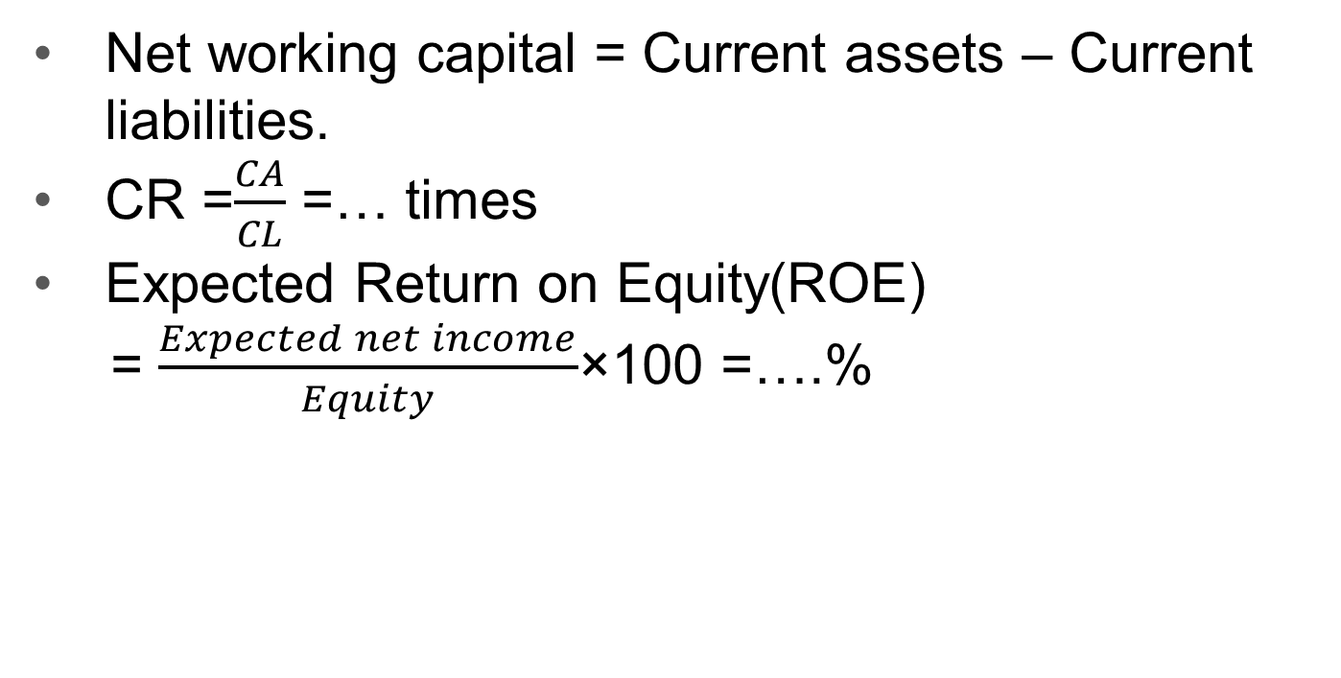
Additional formula
Net working capital = Current assets – Current liabilities.
CR =$\frac{CA}{CL}$ =… times
Expected Return on Equity(ROE)
= $\frac{Expected net income}{Equity}$×100 =….%

Slide 10
Cash budget
Cash budget serves as the most important tool of short term financial planning and controlling the use of cash
It is the primary tool in short -run financial planning
It allows the financial manager to identify short term financial needs and requirement
It is the statement that shows the firm’s projected cash receipt and payment during the plan period

Slide 11
THE END

